Slide 1
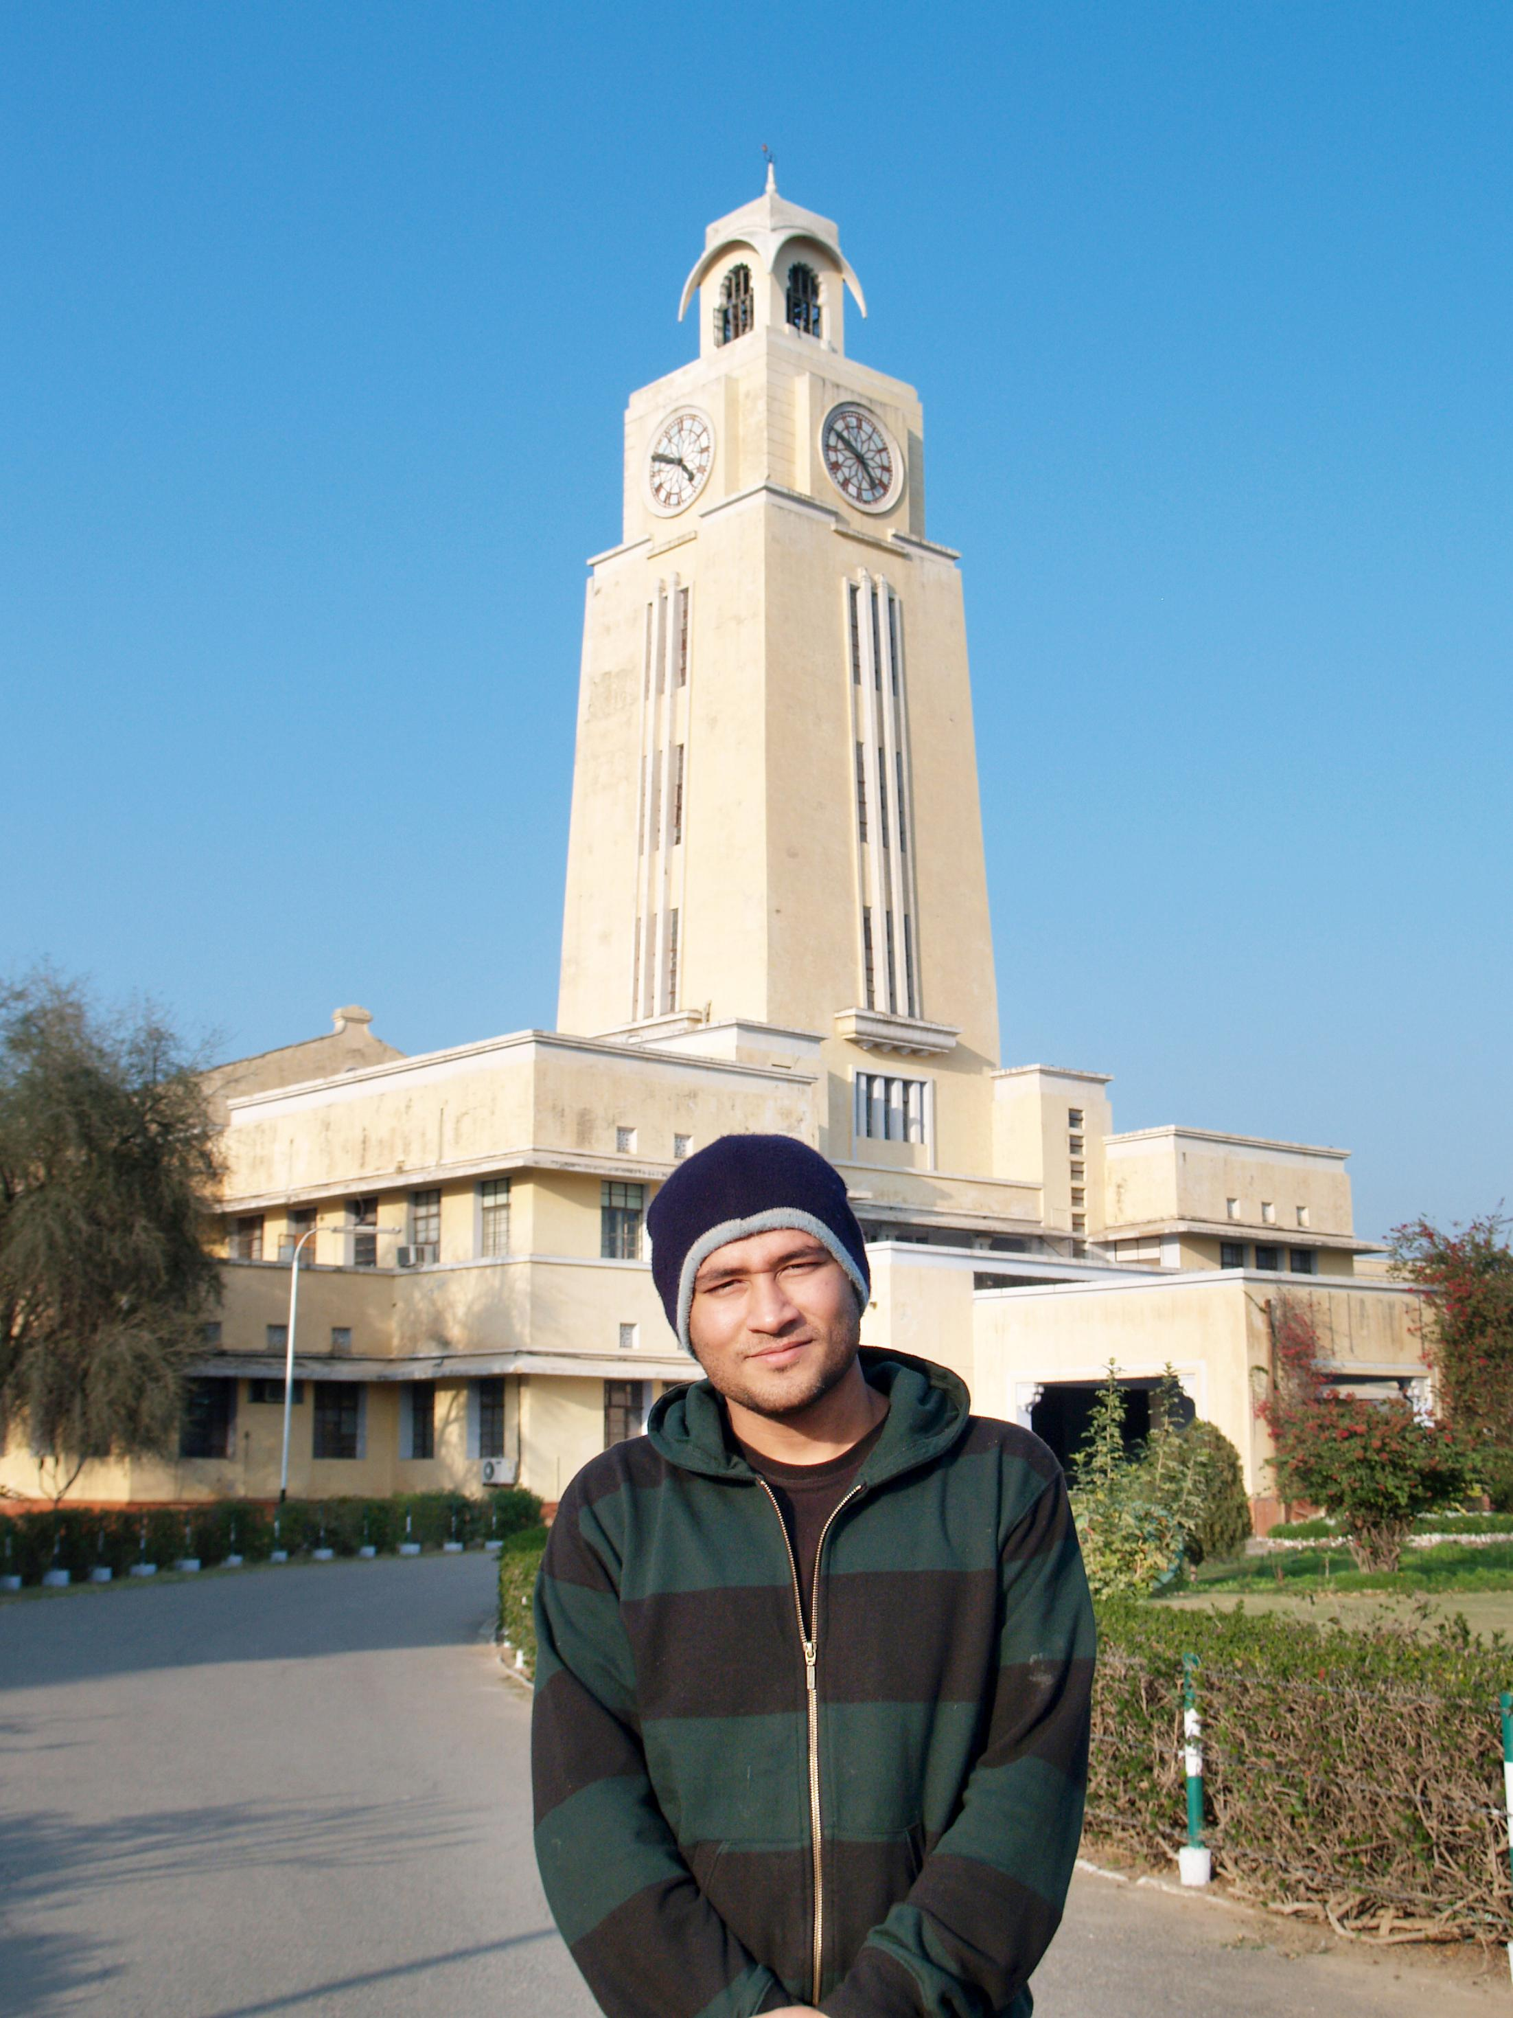


BITS Pilani
Pilani Campus
Advancements in Surveying

Slide 2
Advancements in surveying
TRIMBLE S8 – Most advanced Total Station To date
Distomat DI 1000 - 500 metres
Geodimeter - measures upto 3 kms
Tellurometer - 100 kms (highly skilled persons are required) 2 required.
Electronic Theodolite
Electronic Theodolite
Global Positioning System
Automatic Level
BITSPilani, Pilani Campus

Slide 3
Electro magnetic Distance Measurements
The accuracy of direct measurement and optical measurements is very limited. EDM can measure accuracy up to 1 in 100000 and can measure upto 100 kms.
Depends on generation, propagation, reflection and receiving of waves.
Waves can be typically of radio waves, infra red and visible light …..
50 different EDMs are available in market
BITSPilani, Pilani Campus

Slide 4
Electro-magnetic Distance Measurements
Distomat (Short and Medium distance measurements) :
very small, compact electronic distance measurement device, particularly useful in construction and engineering works.
The Distomat measures distances smaller than 500 meters by simply pointing the instrument to a reflector and reading the result.
Uses infra red waves
Geodimeter
The Geodimeter is often used for nighttime observations and can measure distances up to 3 kilometers.
As this instrument measures distances based on the propagation of modulated light waves, it requires a prism system at the end of the distance you are measuring to reflect the waves.
BITSPilani, Pilani Campus

Slide 5
Electro-magnetic Distance Measurements
Tellurometer (Long range distance measuring device)
The Tellurometer is an electronic distance measurement device that uses high frequency radio waves or microwaves.
This highly portable instrument works on 12 to 24 volt batteries and can be used day or night.
Two Tellurometers are required to measure distances of up to 100 kilometers.
A highly skilled person needs to be at each end of the surveyed area to take measurements.
One Tellurometer is then used as the master, and the other as the remote unit.
BITSPilani, Pilani Campus

Slide 6
Total Station
It is a combination of electronic theodolite and distance measuring device.
Measures only three parameters, Horizontal angle, vertical angle and slope distance……
Total station is also provided with a data logger….
Most total stations can measure angle even upto 5 seconds….
Physics of making measurements
Geometry of calculations
Statistics for analyzing the data of a traverse
BITSPilani, Pilani Campus

Slide 7
Recent Advancements….
Land Surveys complements its traditional surveying services with affordable, rapid response aerial surveying with Unmanned Aerial Vehicles (UAV) delivering spatial data in mining environments for production, asset, environment and heritage management as well as for infrastructure planning and greenfield exploration.
BITSPilani, Pilani Campus

Slide 8
Recent Advancements….
Photogrammetry:
Terrestrial [Terrestrial camera]
Aerial [Aerial camera]
Photo-Thedolite
Remote Sensing….
BITSPilani, Pilani Campus

Slide 9
Thank you very much for the kind attention
BITSPilani, Pilani Campus

